Slide 1
Probability & Random Processes EE2011 Department of Electrical Engineering
NATIONAL UNIVERSITY OF COMPUTER & EMERGING SCIENCES, LAHORE CAMPUS

Slide 2




Slide 3


Slide 4


Slide 5



Slide 6


Slide 7



Slide 8


Slide 9


Slide 10

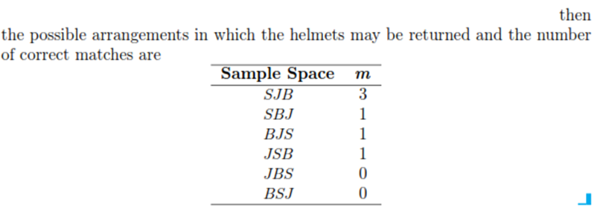

Slide 11


Slide 12


Slide 13




Slide 14




Slide 15



Slide 16



Slide 17

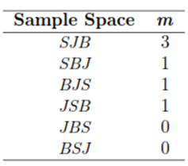


Slide 18


Slide 19
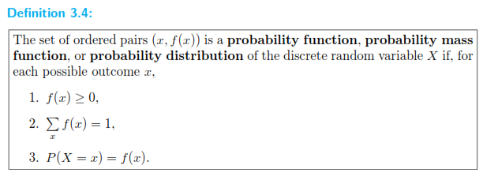

Slide 20


Slide 21

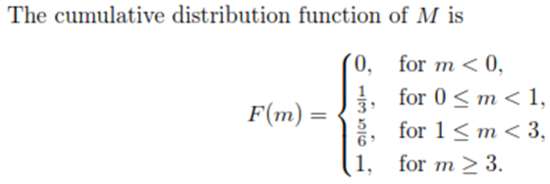


Slide 22

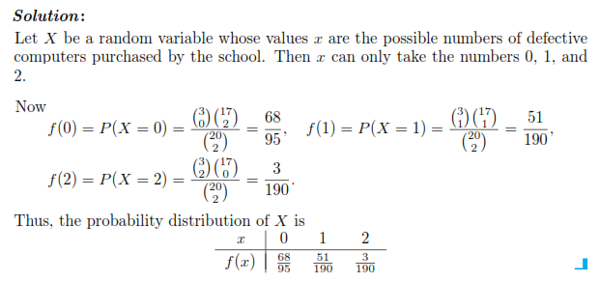

Slide 23






Slide 24



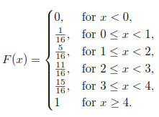
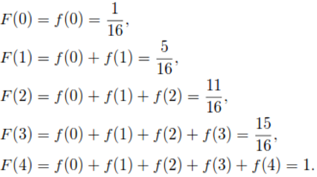


Slide 25


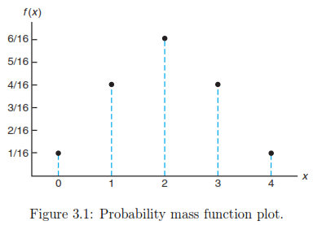

Slide 26
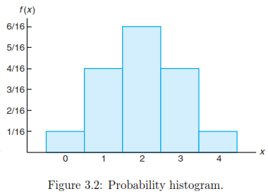


Slide 27


Slide 28
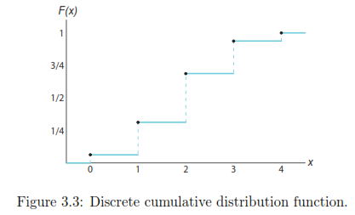

Slide 29




Slide 30


Slide 31


Slide 32

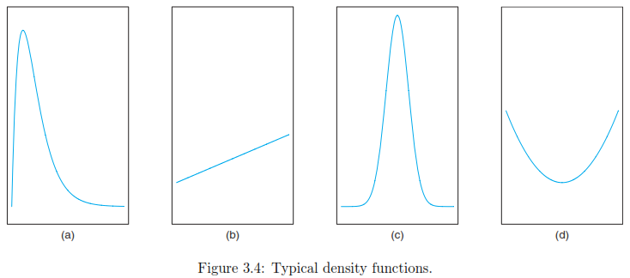


Slide 33



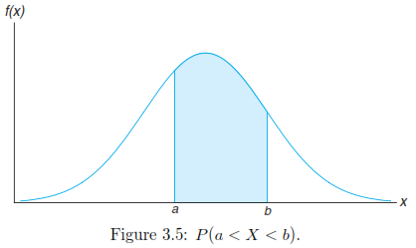

Slide 34


Slide 35



Slide 36






Slide 37



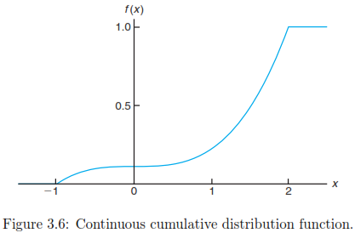

Slide 38


